Slide 1

Humanlytics: An HR Dashboard Software
Muhammed Arslan
Muhammed Tayyab
Dallas Diaz
Ramya Thambabattula

Slide 2
Introduction
The main issue in today’s work world seems to be turnover rates. It can be attributed to COVID, employee satisfaction, benefits, etc.
Not all HR teams within companies know these things so our product should shed more light on what is affecting their turnover rates and how they can get those down.

Slide 3
Objectives:
Focusing on:
Talent acquisition
How can we find the best of the best employees
Employee retention
Looking at factors that make employees stay
Workforce analytics
Layoff Analysis
Sentiment on layoffs and potential suggestions

Slide 4
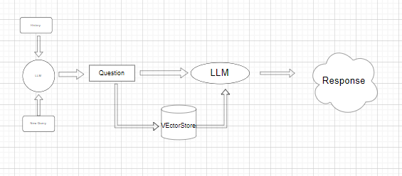
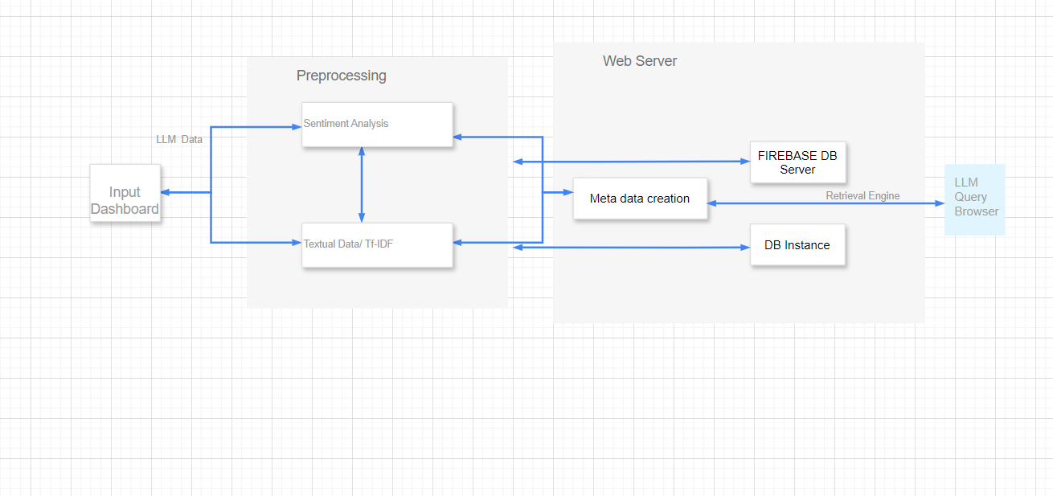
Conceptual/Model Diagram

Slide 5




Specific Data being used
The majority of our data for the initial information comes from Reddit and Twitter.
Listed here are the actual data sets from our google drive

Slide 6
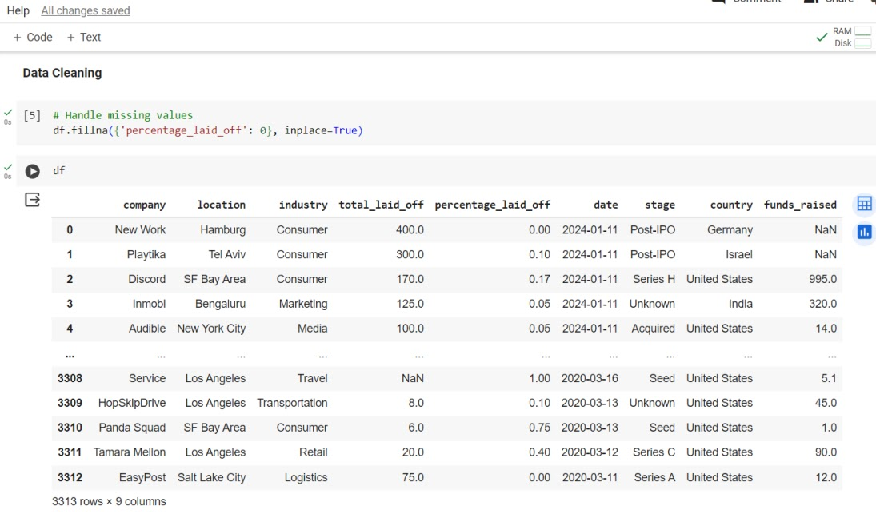
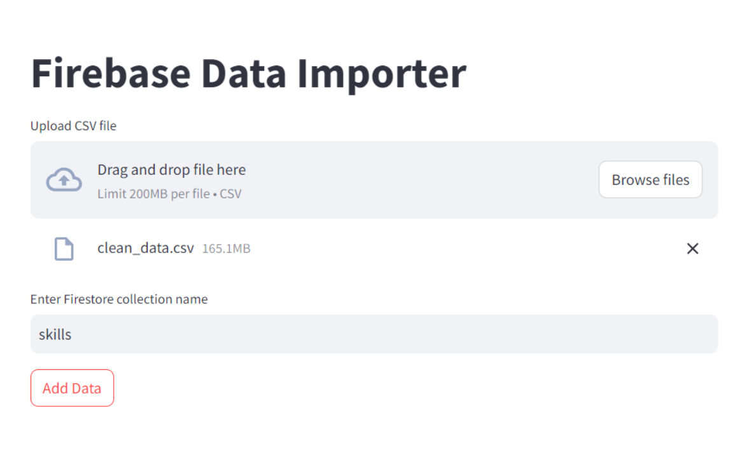
Data Preprocessing and Cleaning
All of the data (coming from reddit and twitter) that was included in the database was retrieved using an API call and cleaned using a jupyter notebook
Once complete, we import the data into the firebase database.

Slide 7
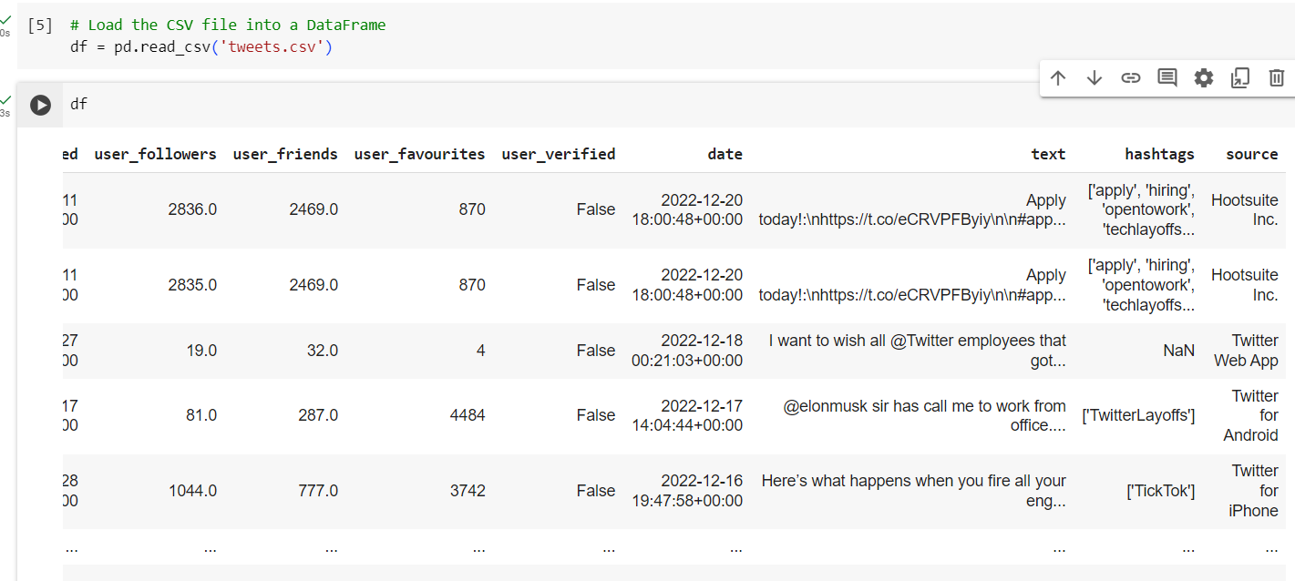
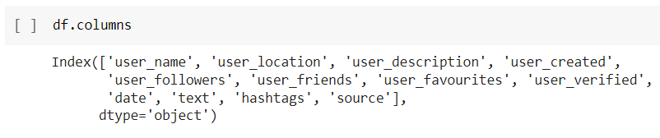
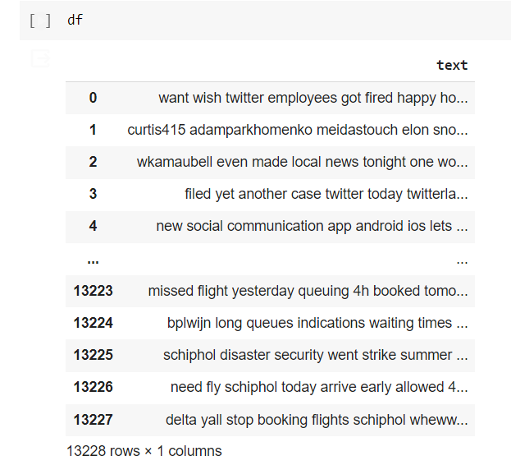

Slide 8
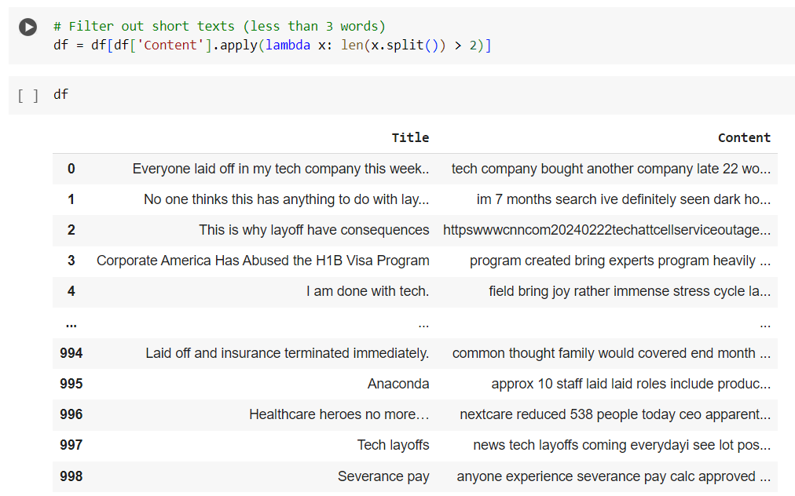
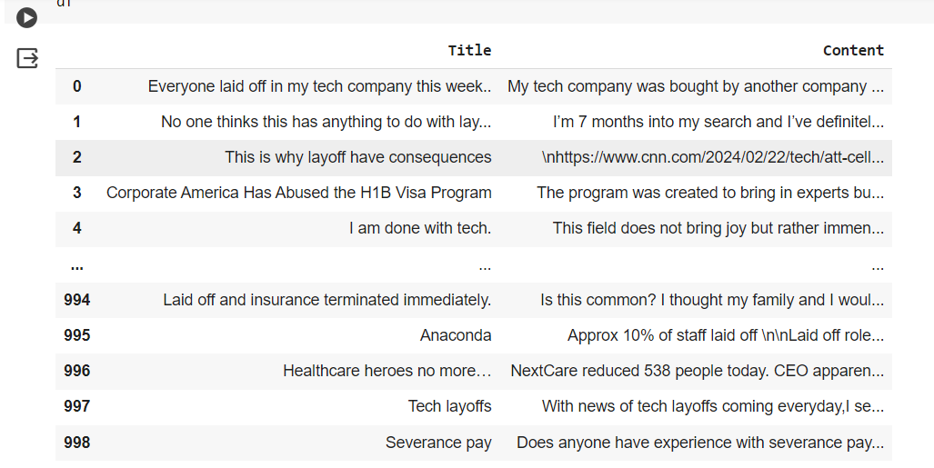

Slide 9
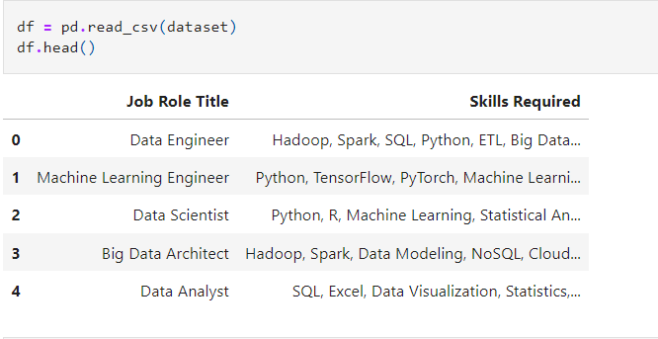
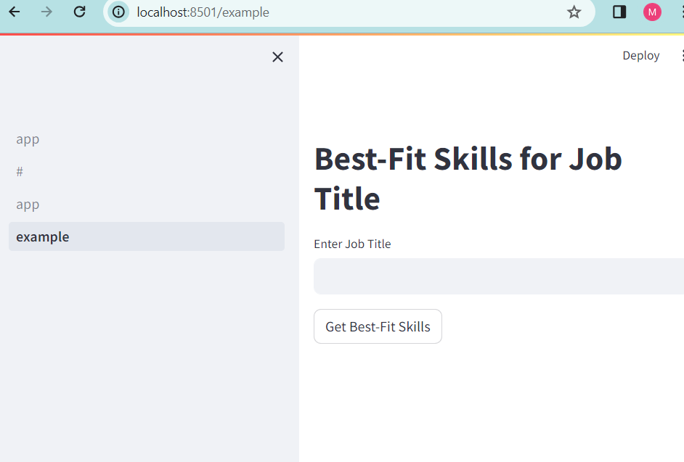
Skills Data
Data scraped for skill matching with the job titles for recommendations.

Slide 10
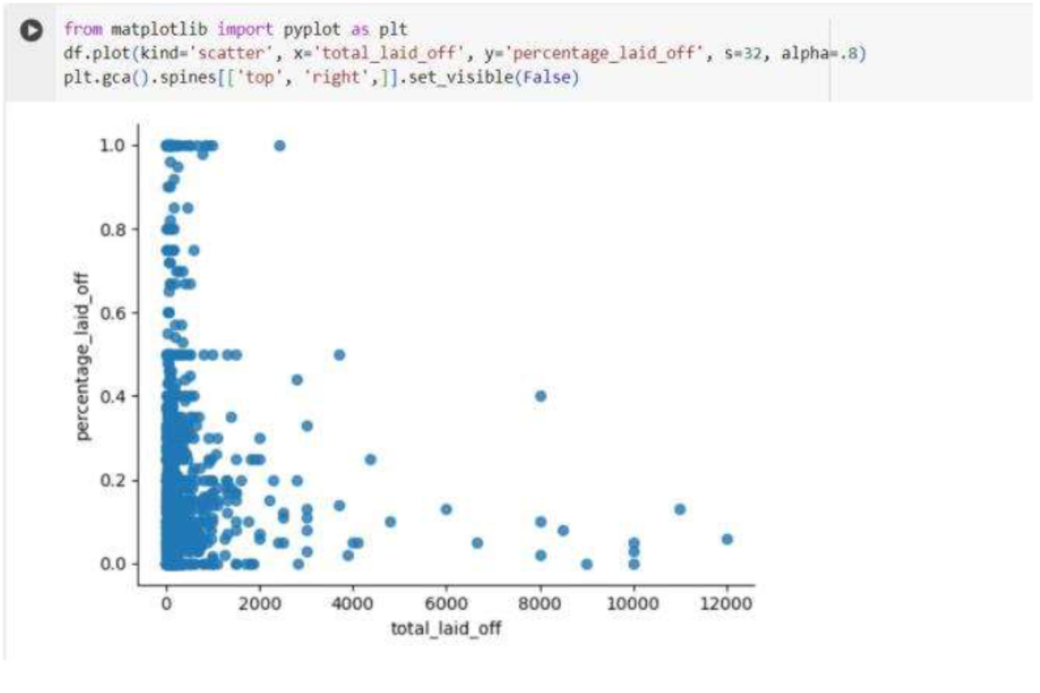
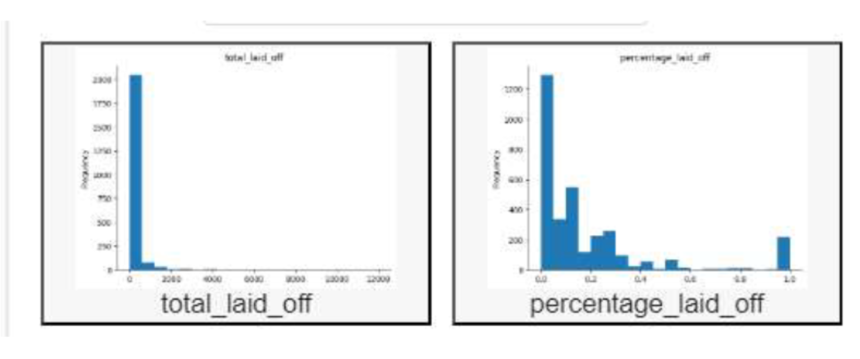
Data Analysis
Initial findings were in the form of graphs and tables before we could utilize our LLM to take the information and make recommendations

Slide 11
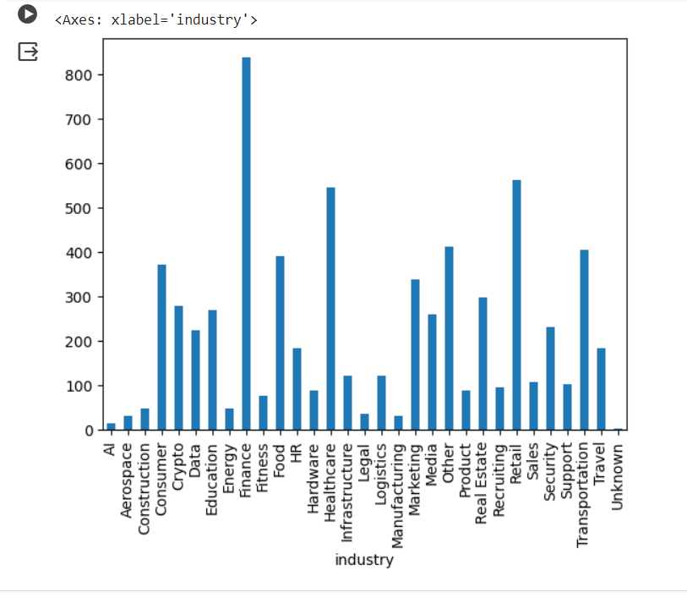
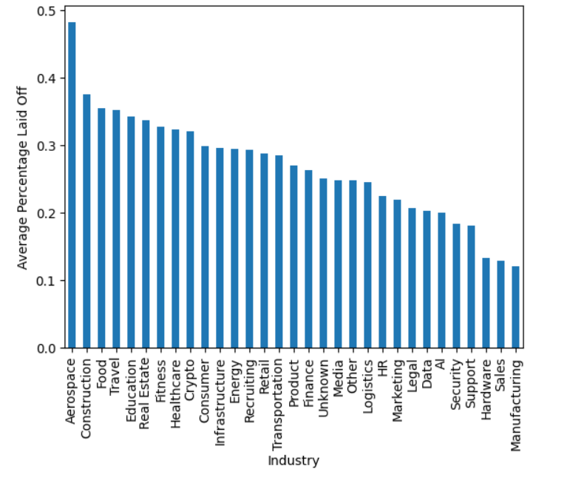
Layoff Data

Slide 12
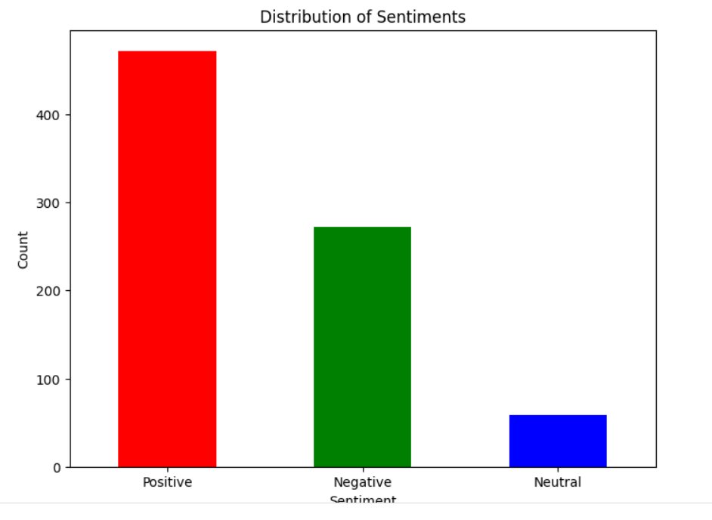
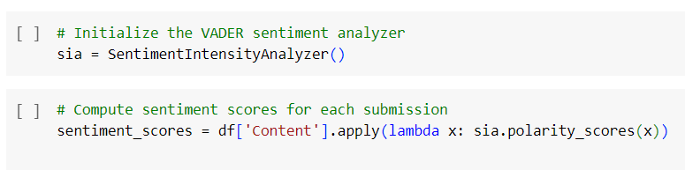
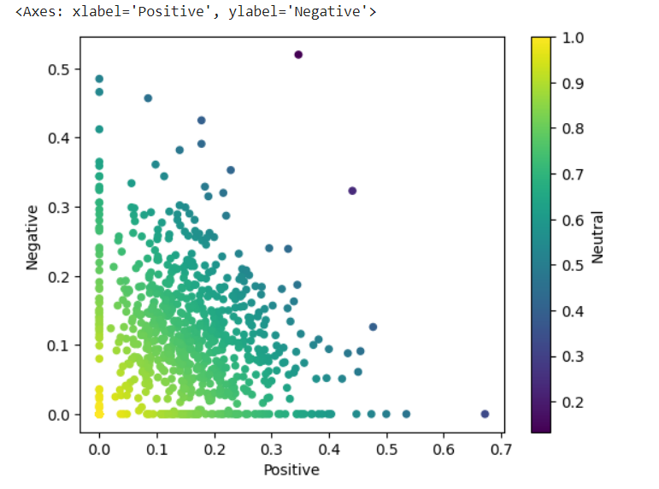
Reddit Data

Slide 13
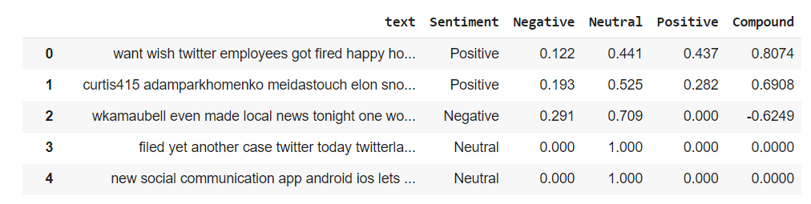
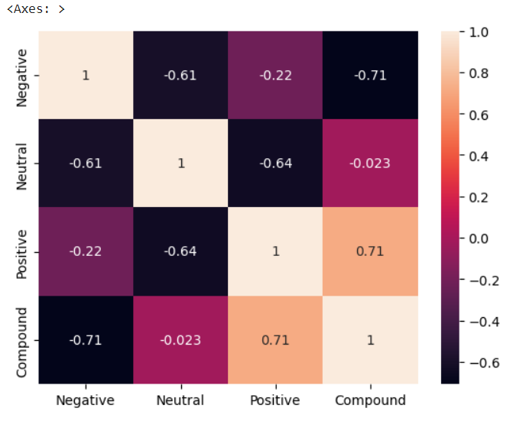
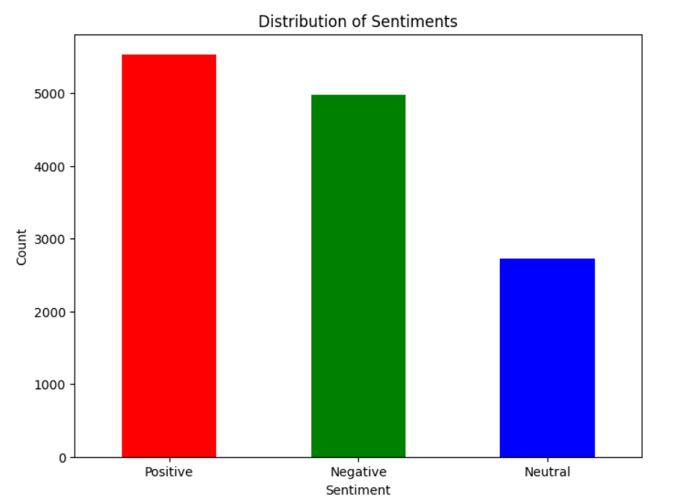
Tweets Data

Slide 14
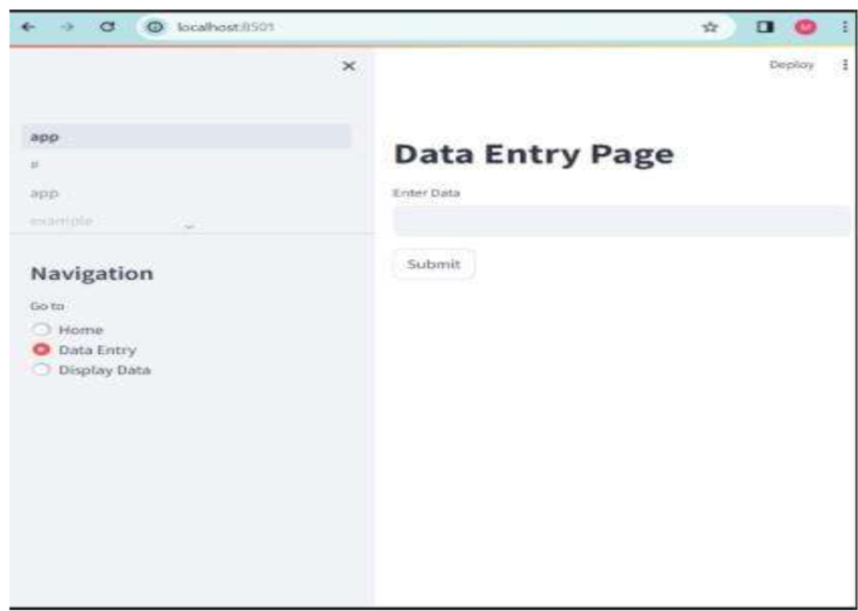
Dashboard Visualization
We were also able to get our streamlit up and running to start presenting something to a user

Slide 15
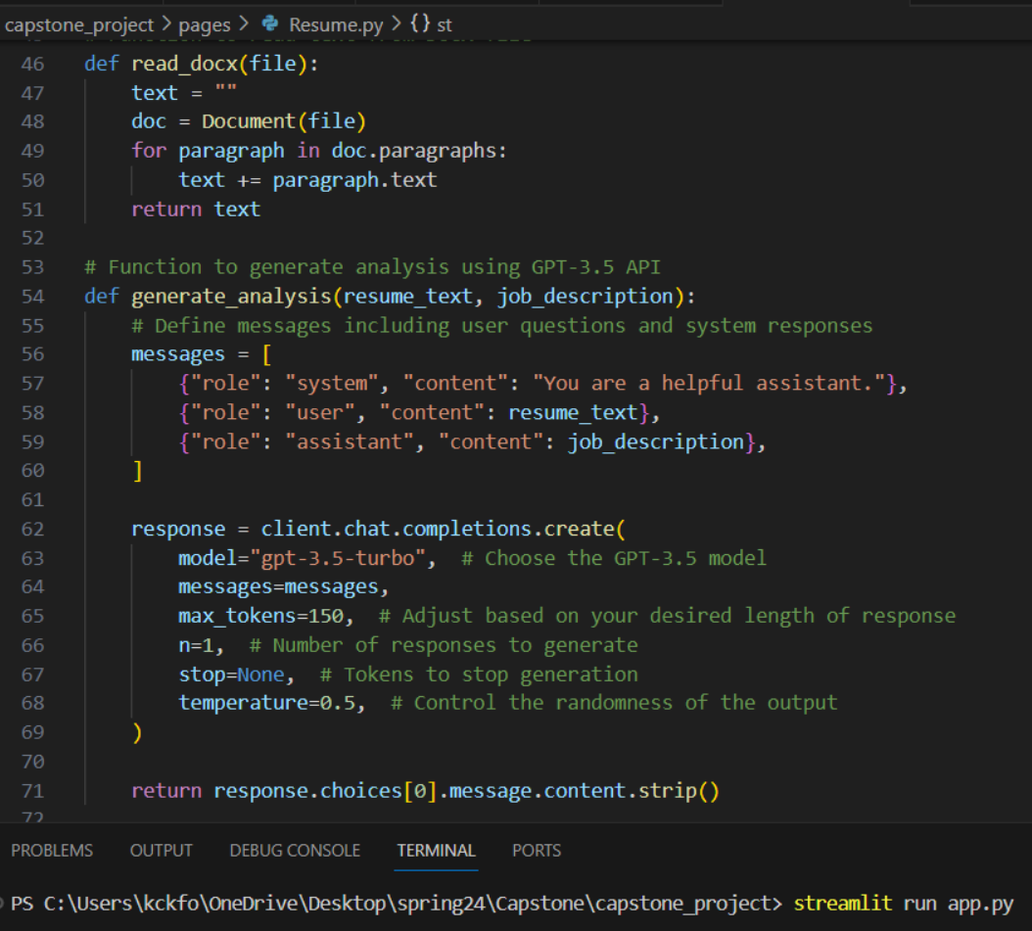
Model Implementation
Our current updates to the model that we are using:
- Our ChatGPT model can retrieve data from our database
- It is fully connected within our triangle model
- It has been trained to make recommendations based off the information it receives.

Slide 16
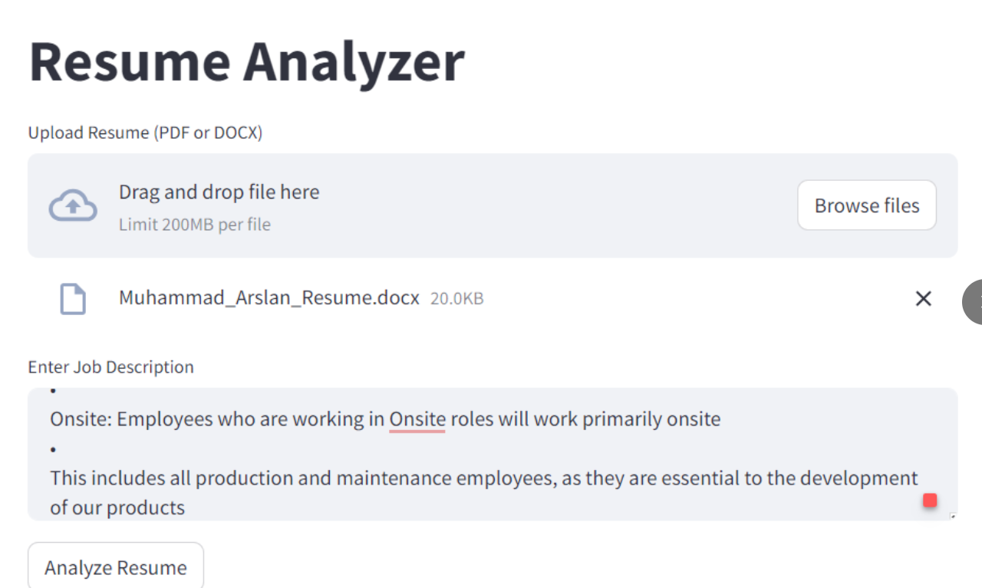
Initial Results
After the triangle model was completely connected, we were able to implement the features of the dashboard.
Current features:
Resume Analyzer
Skills Match
Sentiment Analysis

Slide 17
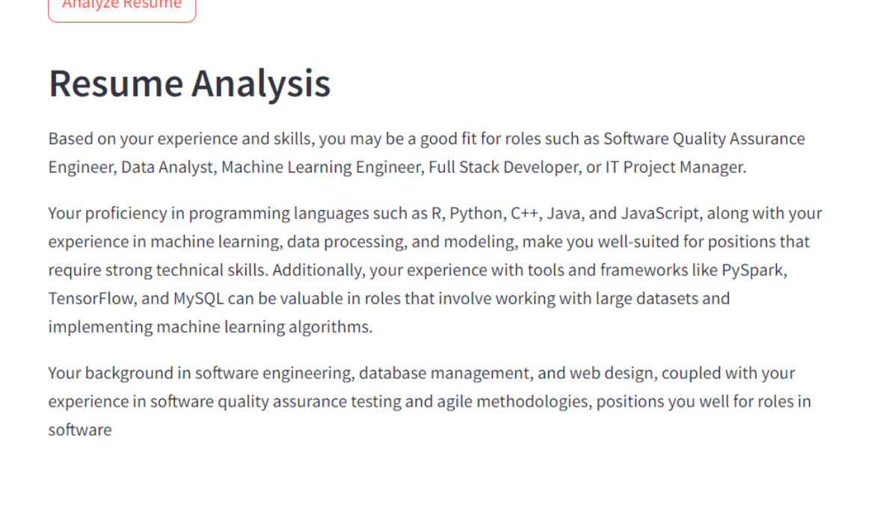
Initial Results
Here is the outcome of the Resume Analysis Functionality Feature:
The Dashboard takes in the input from the user
The LLM takes the information and makes a call to the database to retrieve the information based on the request
It finds a match and returns the output to the user on the front end
17

Slide 18
Next Steps
Finalize the information that is being input into the Firebase database
Clean up the front-end user interface and make it more user friendly and user appealing
Future Steps:
Expand our network to include additional data and make additional recommendations
As more users interact with the dashboard, we will gather more and more information to eventually expand our recommendation features to make recommendations about other items.

